Slide 1
Criminal Risk Analysis
Week 2: Pandas Dataset Cleaning/EDA
Fall 25

Slide 2
Agenda

Slide 3
Work Session Agenda
Icebreaker!
Week 1 Review
Pandas Overview
EDA (Exploratory Data Analysis) and Preprocessing Techniques
Work Time - Dataset Cleaning

Slide 4
1. Icebreaker

Slide 5
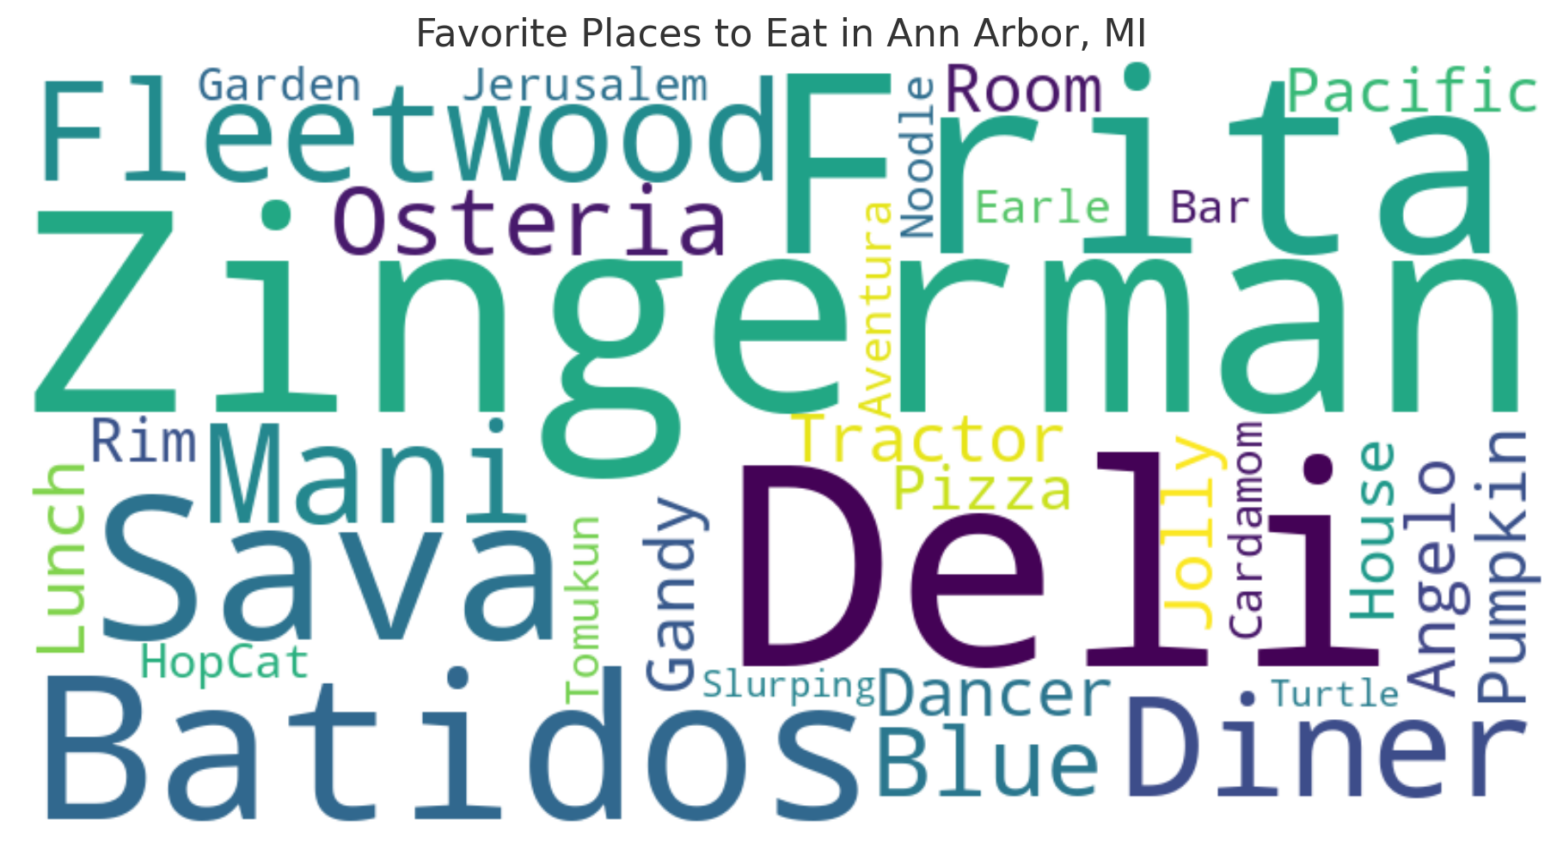
Icebreaker
What’s your favorite place to eat in Ann Arbor? (NO GATEKEEPING)

Slide 6
2. EDA: Exploratory Data Analysis

Slide 7
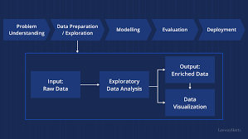
What is EDA?
Definition:
EDA stands for Exploratory Data Analysis.
It is a process used to analyze datasets to summarize their main characteristics, often using visualization tools.
Main Goals of EDA:
Understand Data Structure: Inspect the dataset to understand shape, types, and features.
Identify Patterns and Relationships: Use statistics and plots to find correlations and trends.
Detect Data Quality Issues: Locate missing values, outliers, and inconsistencies that may impact analysis.
Generate Hypotheses: Develop questions and insights that can be further investigated or modeled.
Credit: Leeway Hertz

Slide 8
Significance of EDA
EDA is not just a preliminary step; it's a philosophy of exploring and understanding your data deeply.
The idea is about exploring without assumptions to gain a thorough understanding of data—its context, patterns, and limitations.
It reveals hidden insights and helps in identifying biases and relationships that guide further analysis.
EDA builds trust in the data by ensuring it is well-understood and clean.
Many datasets have missing values such as NaNs or null values. This can mess up your code!
It informs stronger hypotheses and leads to better data-driven decisions.

Slide 9


How We Will Use It Today
Practice on the Titanic Dataset:
Begin with the Titanic dataset to practice key pandas functions.
Understand basic data cleaning steps, such as removing unnecessary columns and imputing missing data.
Apply skills on the COMPAS Dataset:
Use insights from practicing with Titanic data to explore and clean the COMPAS dataset.
Focus on specific project milestones, such as preparing the dataset for fairness and bias analysis.
Prepare for Further Analysis (next week!):
Use pandas to transform and clean both datasets, ensuring data quality before visual exploration and modeling.

Slide 10
3. Pandas

Slide 11


What is pandas?
pandas is a Python library for data manipulation and analysis.
It provides two main data structures: Series (1D) and DataFrame (2D, similar to a table in a database).
The name "pandas" is derived from "Panel Data" and "Python Data Analysis", reflecting its primary use in handling structured data.
Functions like those shown earlier help us quickly understand the dataset’s structure
Identify missing values and discover key patterns
Enables data cleaning and preprocessing—crucial steps to prepare the data for further analysis or modeling.

Slide 12
4. Week 1 Review

Slide 13
Method vs. Function
A method is a function that is called on an object. For example, .head() is a method of a pandas DataFrame object, meaning you use it directly on a DataFrame (like df.head())
Some methods will need the inplace=True flag to modify their original object instead of returning a copy
A function is a standalone procedure, like print()where the input and/or parameters go inside the parenthesis.
Both methods and functions can be void [.apply(), print()] or return an object.

Slide 14
Code Review (Python Syntax)
Syntax | Description
import pandas as pd | Import the pandas library, using the alias pd for convenience
import numpy as np | Import the NumPy library, using alias np for numerical operations
import seaborn as sns | Import Seaborn for statistical data visualization
df = pd.read_csv(‘file.csv’) | Load a CSV file into a pandas DataFrame for data manipulation
df.head() | Returns the first 5 rows of the DataFrame, useful for quickly inspecting data
df.info() | Provides a concise summary of the DataFrame, including data types and non-null values

Slide 15
Code Review (Python Syntax)
Syntax | Description
df.describe() | Generates descriptive statistics of numerical columns (mean, median, quartiles, etc.)
df[‘column_name’] | Access a specific column in the DataFrame, works like a key in a dictionary
df.drop(columns=[‘col’...]) | Drops specified columns from the DataFrame,use inplace=True to modify the original DataFrame
df.index | Returns the index labels of the DataFrame
df.isnull() | returns a DataFrame of boolean values, where each entry indicates whether the corresponding value in df is NaN (missing).

Slide 16
Code Review (Python Syntax)
Syntax | Description
df[‘column’].value_counts() | Returns the count of unique values in a specific column
df[‘column’].mean() | Returns the mean value of a numerical column
df.corr() | Computes correlation for numerical columns to understand relationships
df.columns | Lists all column names in the DataFrame, useful for renaming or viewing dataset structure
df.shape | Renames specific columns to new names

Slide 17
Code Review (Python Syntax)
Syntax | Description
df.rename(columns={'old': 'new'}, inplace=True) | Renames specific columns to new names
df.groupby(‘category’)[‘value’] | Groups the DataFrame using a specified column to perform aggregate functions (e.g., .sum(), .mean()).
df[‘new_column’] = df[‘column’].apply(function) | Applies a function to each element or column/row
df.shape | Returns a tuple representing the dimensions (rows, columns) of the DataFrame.
df.dropna() | Removes rows or columns containing missing values

Slide 18
Code Review (Python Syntax)
Syntax | Description
df.unique() | Returns an array of unique values in a column
df.reset_index() | Resets the index of a DataFrame, often used after groupby or dropping rows
str.split() | Splits strings by specified delimiter (space if blank)
str.strip() | Removes leading and trailing whitespace from strings
df.str | Accessor for applying string functions to a pandas Series
df.map(dictionary) | Maps the elements of df to a dictionary where the elements are the keys and they are transformed into the key’s value.

Slide 19
Numpy Review
What is NumPy and Why Are We Using It?
NumPy stands for Numerical Python library, essential for numerical computations in Python.
Provides fast, efficient arrays and a wide range of mathematical functions.
Key tool for scientific computing and handling large datasets effectively.
NumPy's Relationship with pandas and Its Role in EDA
Foundation for pandas: pandas is built on top of NumPy; DataFrames internally use NumPy arrays.
Exploratory Data Analysis (EDA): Enables data manipulation, statistical analysis, and complex calculations required for understanding data before visualization or modeling.

Slide 20
Seaborn Review
What is Seaborn and Why Are We Using It?
Seaborn is a data visualization library built on top of Matplotlib, designed for creating attractive and informative statistical graphics.
Provides high-level functions for visualizing data patterns, such as distributions, relationships, and trends.
Easier and more aesthetic compared to Matplotlib for generating complex plots with fewer lines of code.
Functions like sns.countplot(), sns.boxplot(), and sns.pairplot() provide valuable insights into dataset structure.

Slide 21
5. Work Time!

Slide 22
Exploring the COMPAS Dataset
Find the notebook in Will’s GitHub:
Split into teams of 2-3
Ask questions, Google it, and help those around you!
Make sure when reading in files you use your “file’s path!”

